Slide 1
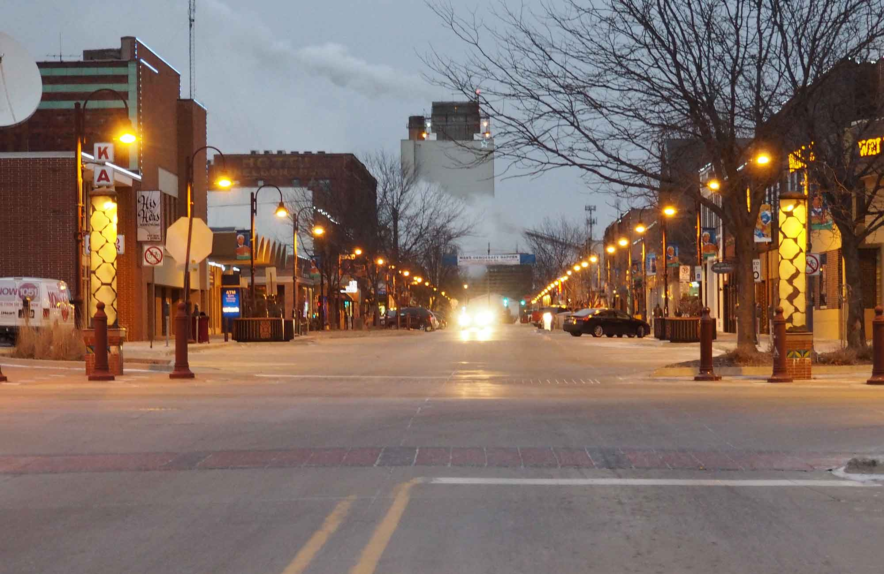
HOUSING DATA ANALYSIS
AMES IOWA
by
Angela Kunanbaeva

Slide 2
Housing market analysis
Identify key features that have the greatest impact on selling price
Guidelines to selling/buying the house in Ames, Iowa
Best fit model that predicts the selling price

Slide 3
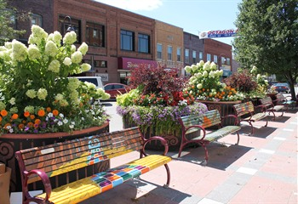
Overall observation
Average selling prices despite the 2008 crisis stayed the same
73% of houses sold are less than 2000 sq.ft
Most of the houses sold have garage space for 2-3 cars

Slide 4
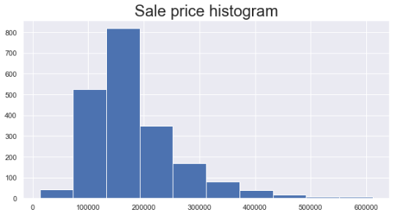
$12 800
Lowest price
$181 500
Average price
$612 000
Maximum price

Slide 5
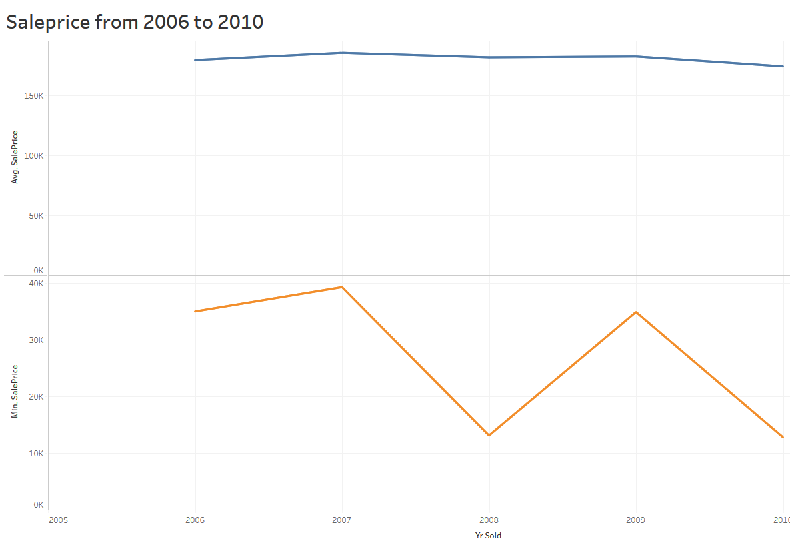
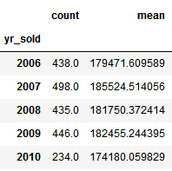
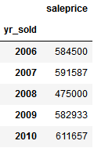
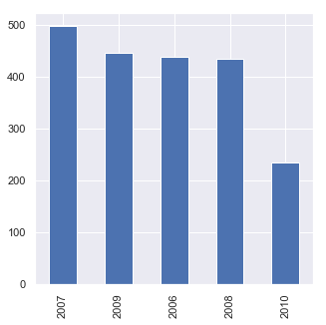
Housing sale prices from 2006 to 2010

Slide 6
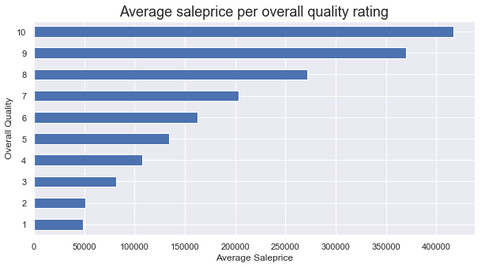
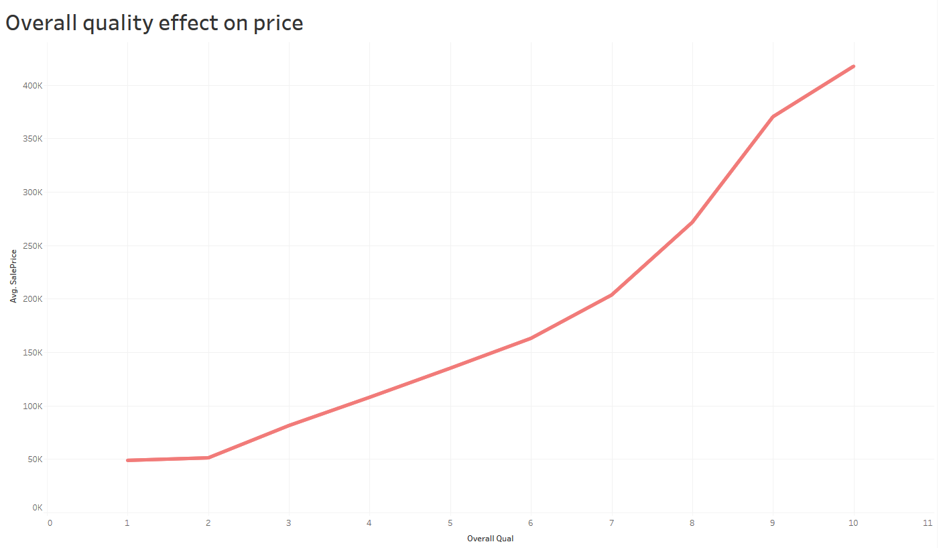

Slide 7
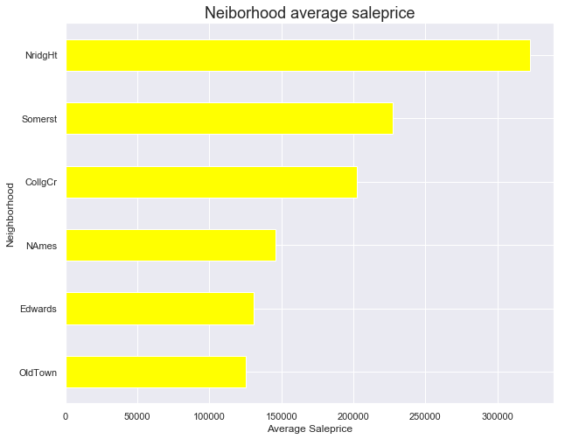
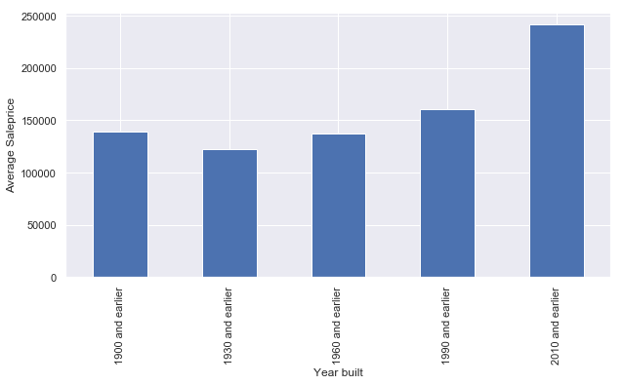
Location and year built
Average price per Year built

Slide 8
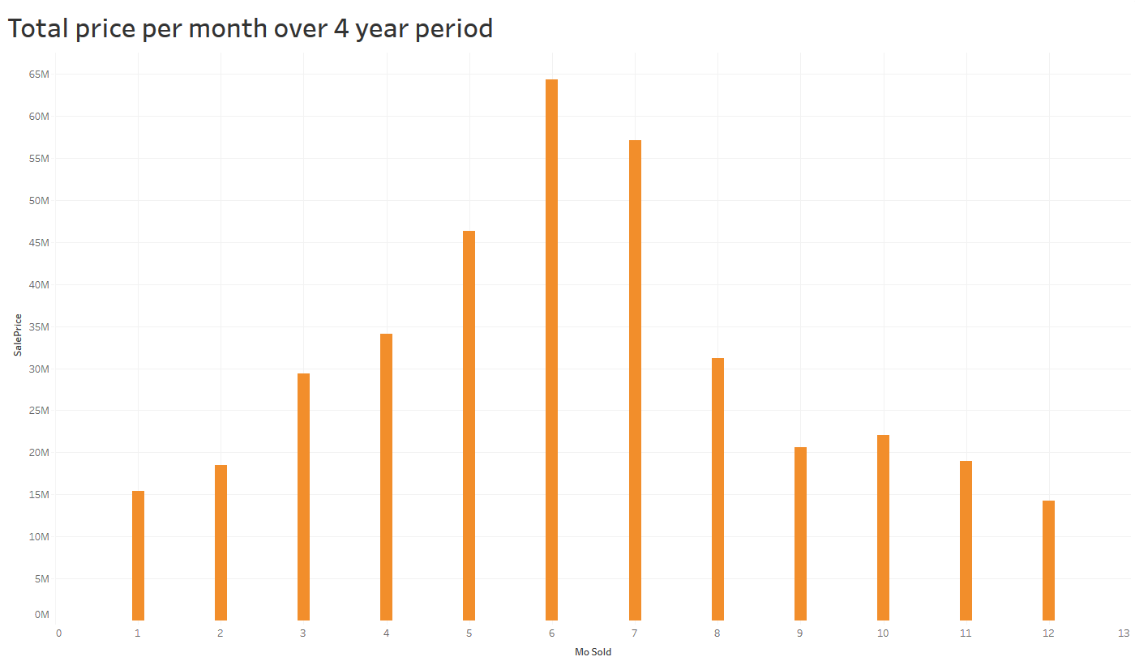
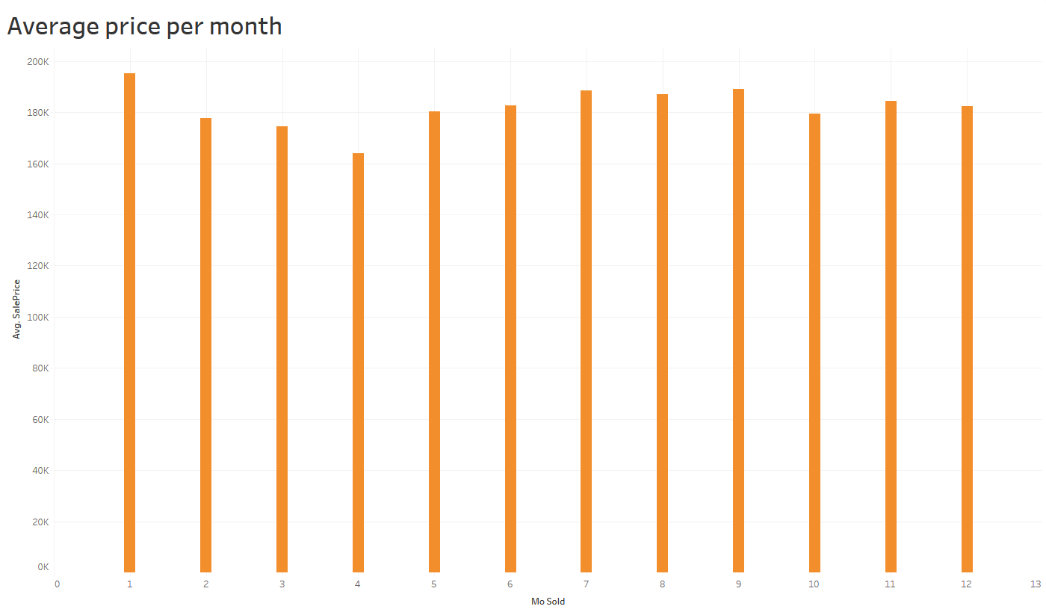
Sell in June
Don’t sell in April

Slide 9
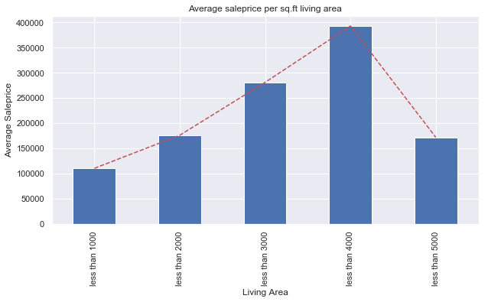
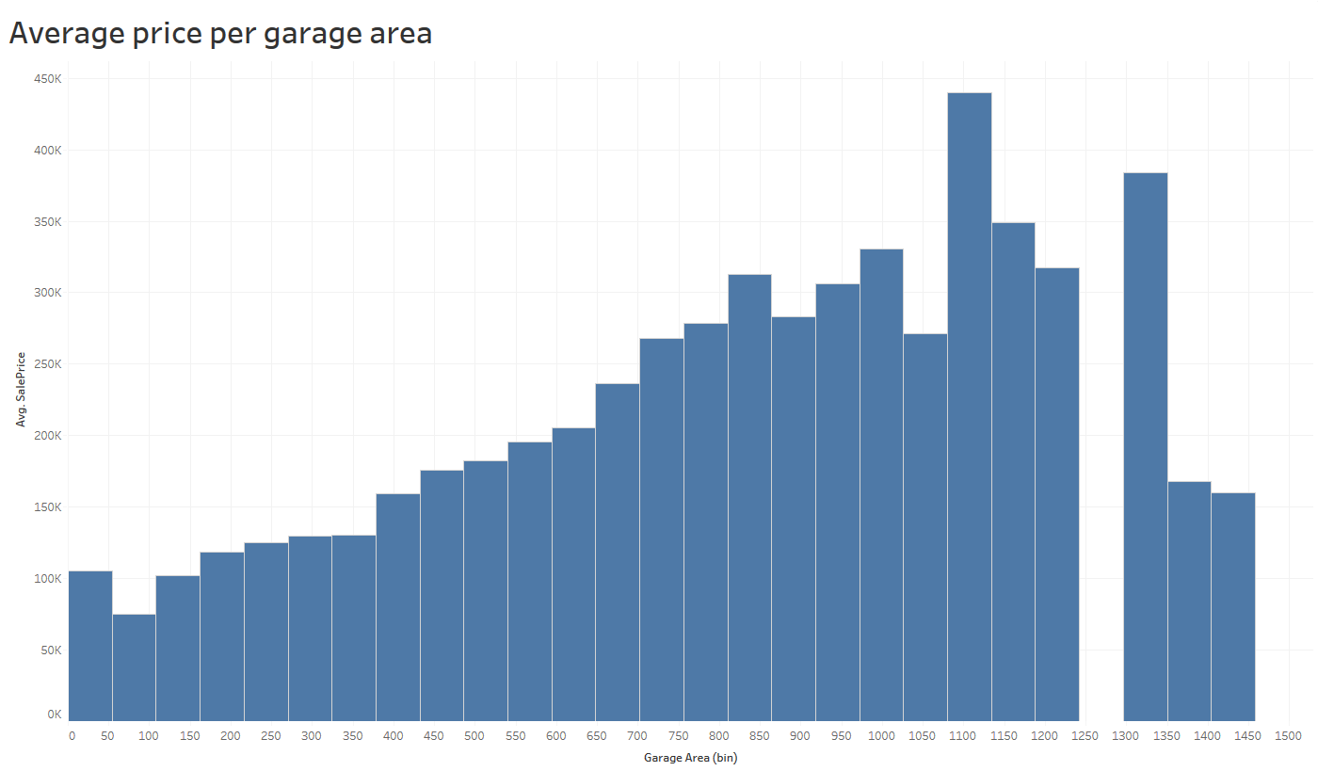
Don’t buy houses more than 4000 sq.ft
Build garages up to 1350 sq.ft

Slide 10
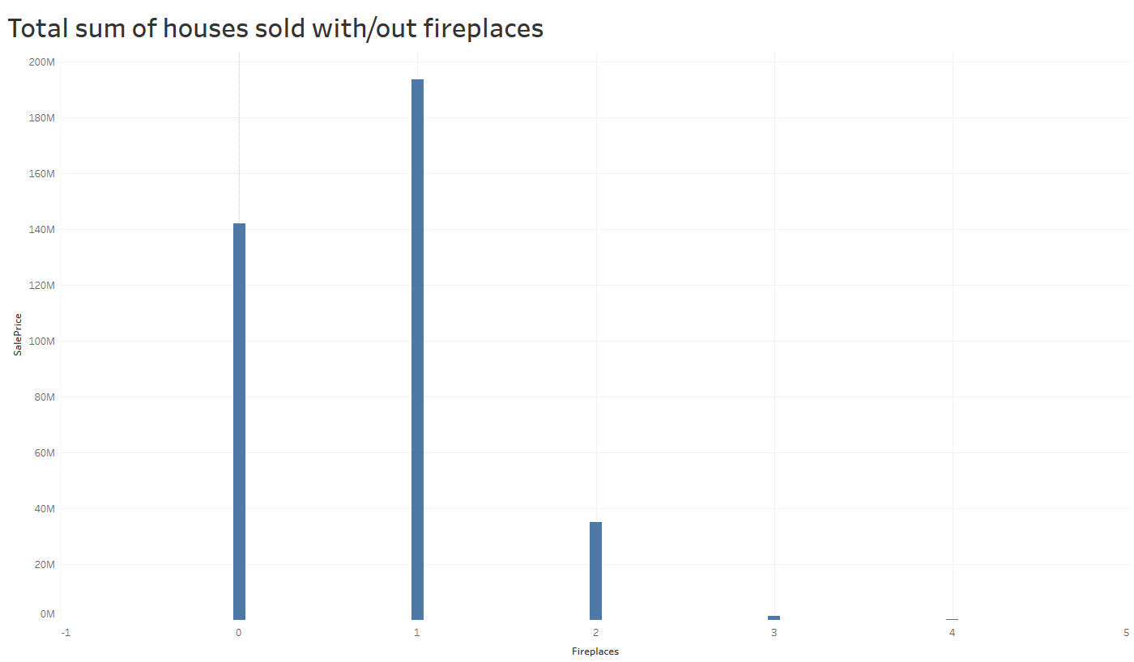
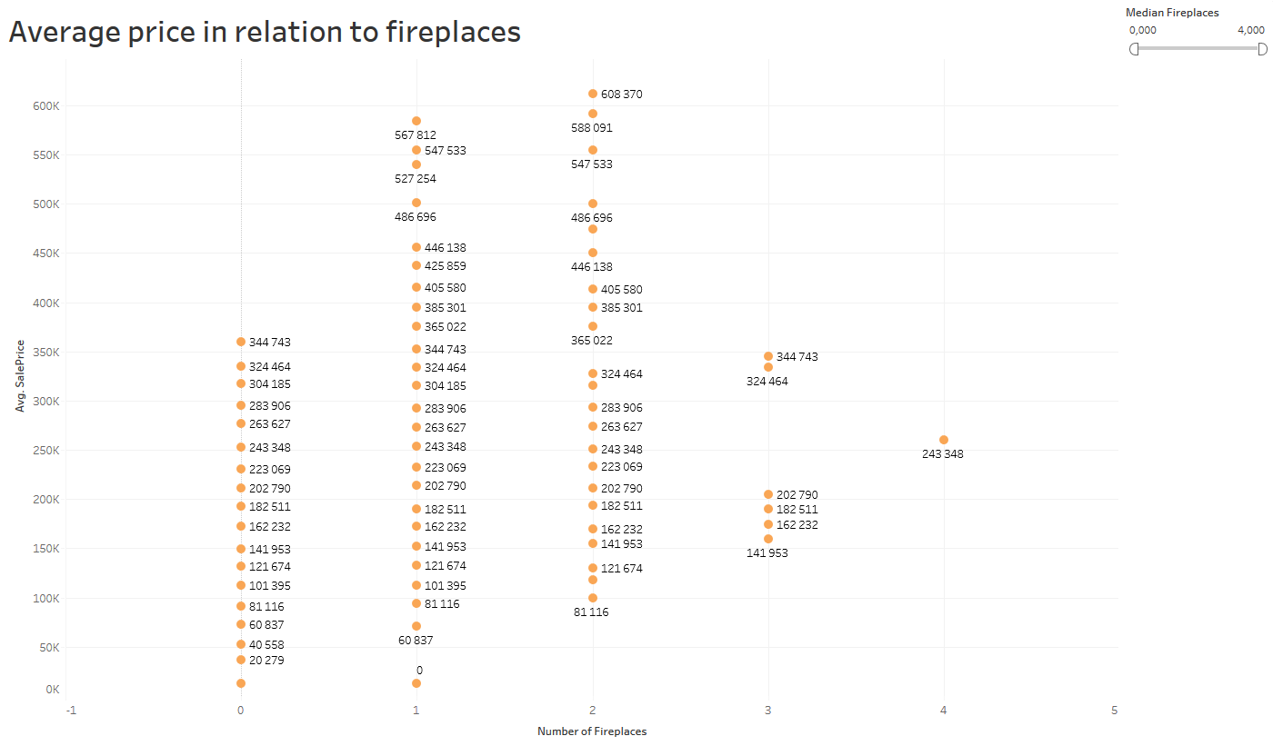

Slide 11
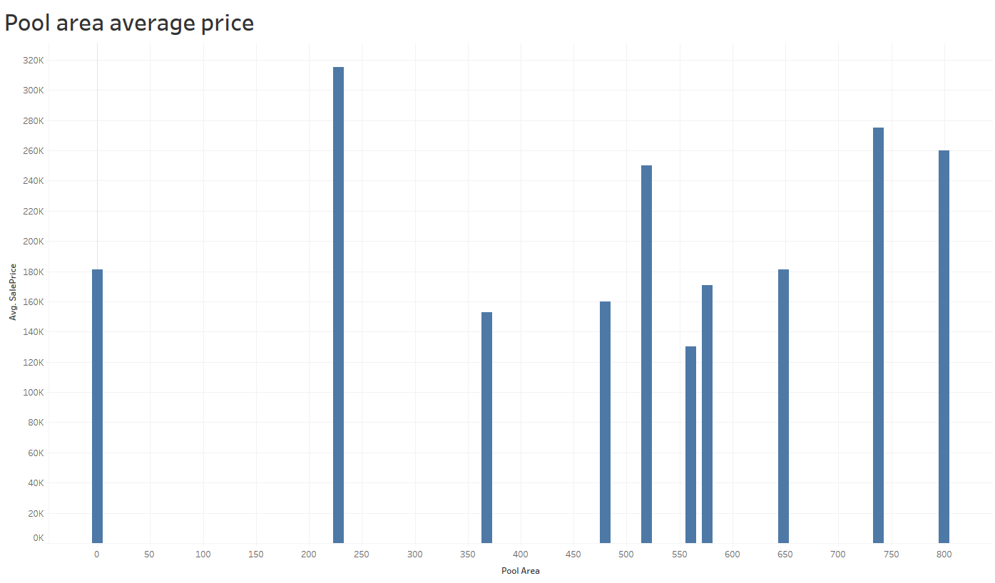
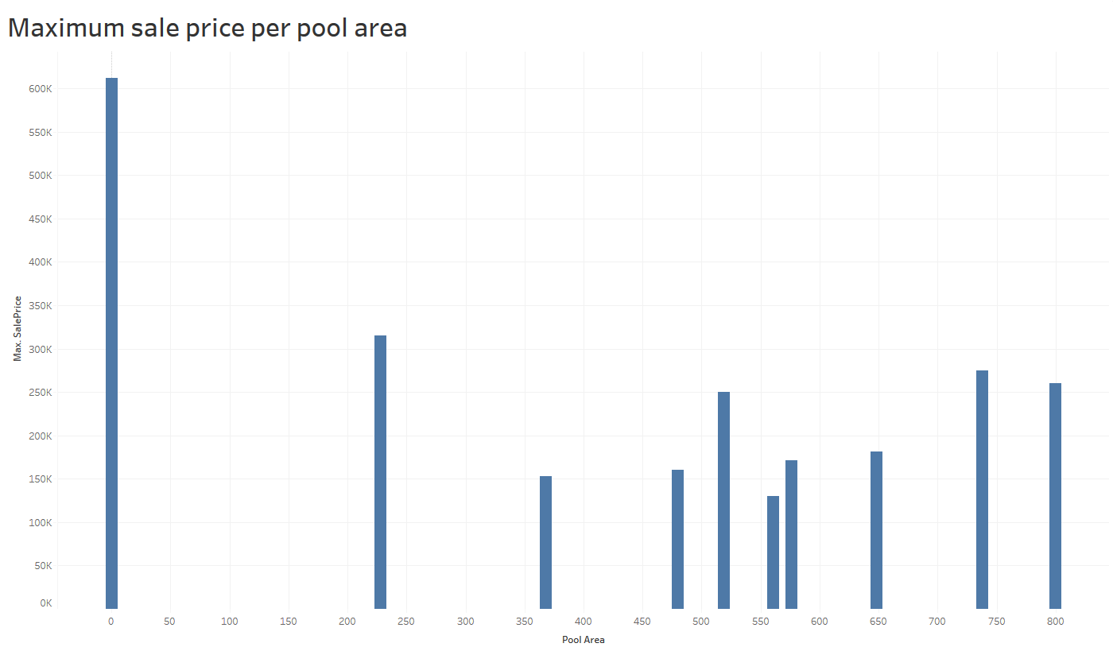

Slide 12
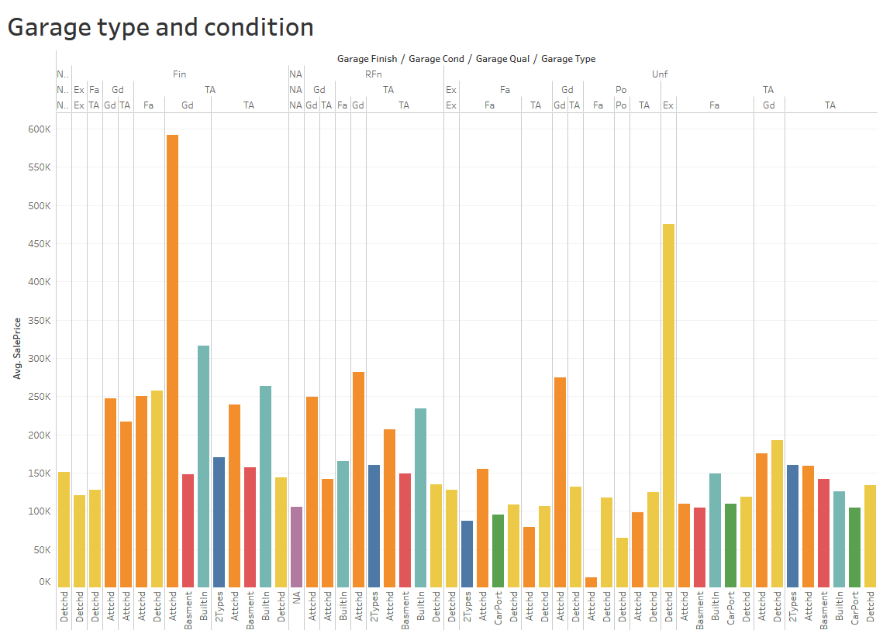

Slide 13
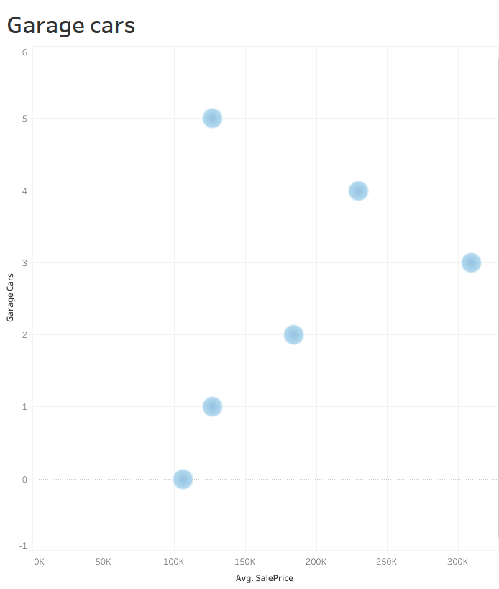
Attached in Good condition
Dettached in Excellent
No more than 3 cars

Slide 14
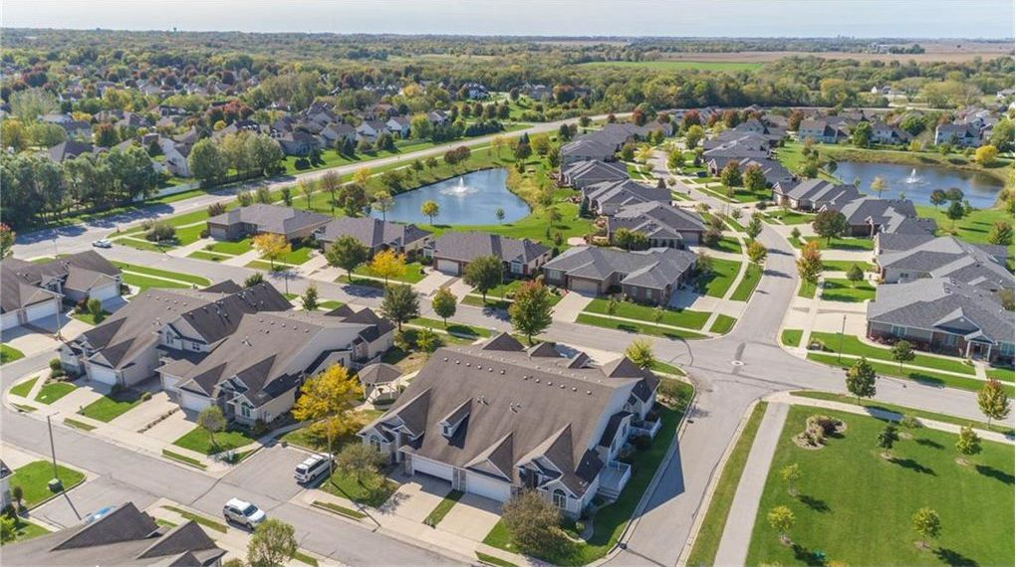
General observations
Certain features such as Overall quality and Sq.ft area, and of course Location have practically linear relationship with the Sale price
Above grade quality of Exterior, Kitchen quality, Garage condition certainly plays important role
The newer the house the better the price

Slide 15
Interesting…
There is 140 thousand price jump from not having a pool to having a pool. Yet as the pool area increases the prices doesnt necessarily follow this trend. As long as you have a pool up to 250sq.ft you'll can claim the higher value for your house
Garage cars: if your garage fits 2-3 cars you can claim the higher average price for your house, but having more spaces in your garage doesn't linearly adds up to the selling price
Absence or presence of the fireplaces doesn't result in price jump, but having 1-2 fireplaces certainly increase the value. Yet 3 or more fireplaces don't
The most number of houses sold in warmer months starting from May till August. This may be due to school migration effect, when families move to a different area so children can attend certain schools
Also, not having school district as a feature in the dataset limits the model.

Slide 16

?

Slide 17
Quality at least above average
Overall
Exterior
Garage
Kitchen
Sell in summer
Garage is very important
Pool not so much

Slide 18
THANK YOU!

